Slide 1
Application of UML for Hardware Design Based on Design Process Model
By Robertas Damasevicius, Vytautas Stuikys
Presented by Matt Roth

Slide 2
Why use UML?
Hardware designers coming under strain
Originally tried to design reliable and efficient hardware
Hardware designers objective not create new soft IPs
Design Process and UML
Reasons

Slide 3
How UML is used
Application of UML for hardware design
Application of design patterns for hardware design
High-level hardware language can be generated from UML diagrams
UML can be used at all levels of hardware abstraction

Slide 4
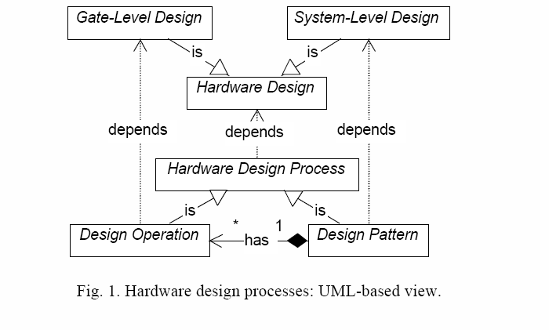
Hardware Design Process

Slide 5
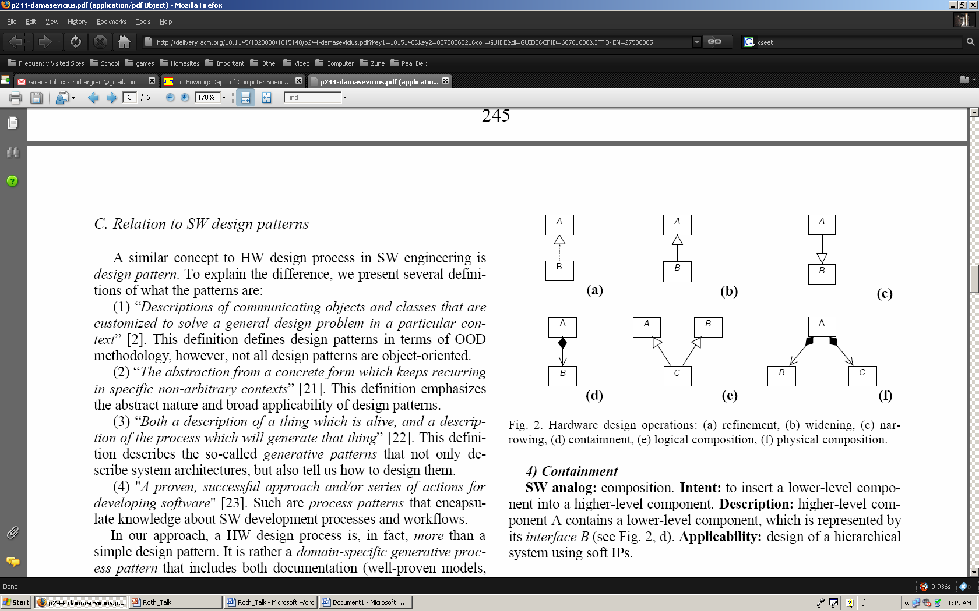
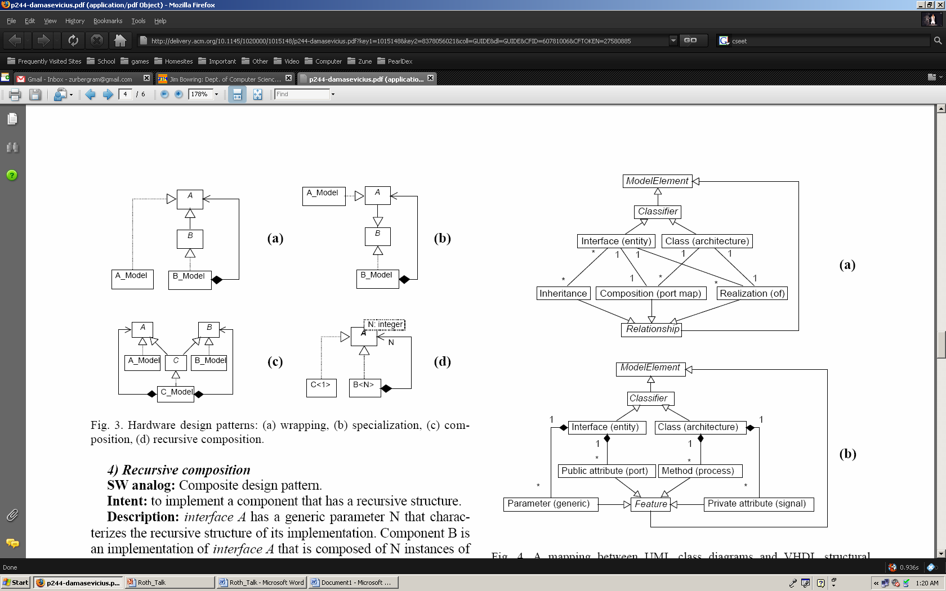
Hardware design operations and patterns

Slide 6
Conclusion
Why hardware uses UML?
How hardware uses UML?
Hardware design process, operations, and patterns

